Slide 1


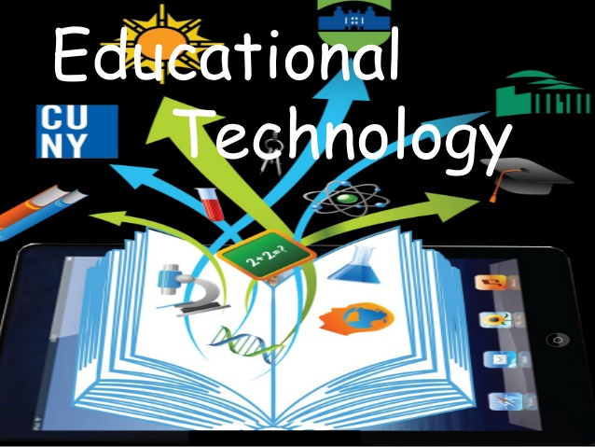
Student's Name
AHMED MOHAMMED MASHYAKHI
Kingdom of Saudi Arabia
Ministry of education
King Khalid University
DR
HAMED AL_SHAHRANI

Slide 2

Course
ENGLISH READING
IN
EDUCATION TECHNOLOGY

Slide 3
Educational presentation Objectives
Definition of Educational Technology.
Traditional Education.
E-Learning.
Advantages and Disadvantages of Traditional Education.
Advantages and Disadvantages of E – learning.
Types of E-learning.
U-Learning.

Slide 4
Definition of Educational Technology
Modern teaching aids used in teaching and learning
Learning through the use of modern technology
the study and ethical practice of facilitating learning and improving performance by creating, using, and managing appropriate technological processes and resources

Slide 5
Definition OF Traditional education
Education using old teaching aids
Use of traditional methods and old teaching methods based on teaching curriculum and content for students and the use of old educational tools such as blackboard, pens and textbook and the teacher is only to display any information regardless of the level of mental or age or efficiency
It depends on three basic pillars: teacher, learner and information.

Slide 6
E-Learning
The delivery of a learning, training or education program by electronic means

Slide 7
Advantages of Traditional Education.
Meet the teacher and the learner face to face.
Can be implemented in various educational
environments.
3. Served a large slice of society due to previous living conditions.
4. Financial cost is lower.

Slide 8
Disadvantages of Traditional Education
The negative role of the student as he is here only recipient of the information.
2. The traditional approach concerned the mental aspect of the student.
3. The subjects focused on conservation and indoctrination.
4. non-observance of individual differences among students

Slide 9
Advantages of E – learning.
  The student is the foundation.
  Self-learning.
  Provides more and more learning tools.
  Continued learning outside the school walls.
  Eliminate the problem of individual differences.
  The teacher's role is directed, facilitator and facilitator of the educational process.

Slide 10
Disadvantages of E – learning.
It needs a high cost especially at the beginning.
There is no direct interaction between teacher and learner
Difficulty the student learns about his colleagues because they are from different places.

Slide 11
Types of E-learning.
First :Synchronous E-Learning
Direct interaction between teacher and learner through instant chat or virtual classes.
Synchronous e-learning tools:
(whit Board)
(Virtual Classroom)
(Video Conferencing)
(Chatting Rooms)

Slide 12
Types of E-learning.
Second : Asynchronous E-Learning
Indirect interaction between the teacher and the learner by using the learner's content only then interacting by e-mail with the teacher to question and then reply from the teacher at a later time.
Asynchronous electronic learning tools:
(E-mail)
(World Wide Web)
(Mailing List)
(Discussion Groups)
(Files Transfer)
(CD)

Slide 13

What is U-Learning ?
E learning system based on formalized teaching but with the help of electronic resources is known as E-learning. While teaching can be based in or out of the .classrooms
E - LEARNING
Ubiquitous learning
M - LEARNING
M-learning or mobile learning is "learning across multiple contexts, through social and content interactions, using personal electronic devices".

Slide 14
Thank You For Your Attention

